Slide 1
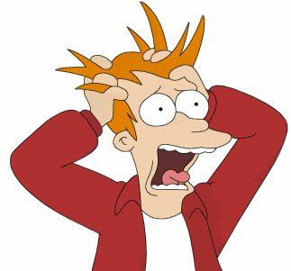
Stress

Slide 2
What is Stress?
Stress has been defined as “the adverse reaction people have to excessive or prolonged pressure or other types of demand placed on them”
The feeling of being under too much mental or emotional pressure
When the buzz becomes overwhelming and the person perceives that they can no longer cope.
Notes:
A reasonable amount of pressure or challenge can be stimulating, motivating or give a “buzz”, but stress occurs when the demands of pressures become overwhelming and the person perceives that they can no longer cope with them.

Slide 3
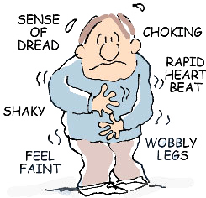
What can cause stress or anxiety?
Many of life’s demands can cause stress and anxiety such as:
Work – work pressure, boredom, no variation, bullying
Relationships – divorce, separation
Financial problems – debt, redundancy, job insecurity
Health concerns – ongoing or newly diagnosed health issues.
Family commitments – child care, elderly relatives
Notes:
It’s worth noting that everyone reacts to stress in different ways, so a situation that feels stressful to one person may be motivating to someone else.
Many of life’s demands can cause stress or anxiety and the overwhelming feeling of not being able to cope. Stress causes a surge of hormones in your body. These stress hormones are released to enable you to deal with pressures or threats – the so-called "fight or flight" response.

Slide 4
Is stress an issue ?
Notes:
In 2015, CPI undertook an industry wide absence from work survey. From the 53 responses received and based on absence data from the period 1 July 2014 – 30 June 2015. Stress was the second biggest reason for absence, accounting for 1250 days lost.
The cost to business - If we take £250 per day as a minimum to cover for absence form the 53 respondents that figure equates to circa £310k cost to businesses
If we factor in the other CPI sites and assuming they all have some stress related absence. Over 12 months that figure could increase to £1.2m!

Slide 5
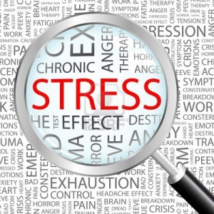
Recognising Stress
People react in different ways, these are just some of the effects stress might have on individuals:
Emotional effects: anxiety, anger, frustration, low self esteem
Physical effects: tenseness, headaches, tiredness from lack of sleep
Psychological effects: impairment of perception, concentration
Social effects: relationships may become difficult
Behavioural effects: being short tempered, crying
Notes:
People can react in different ways to stress, they may show some or all of the signs above at different times.
When feeling stressed it can get in the way of sorting out or dealing with an issue thus affecting everything that needs to be done or addressing the problem.
Stress can affect how a person feels, thinks or behaves as well as how the body works. Common signs of stress include sleeping problems, seating, loss of appetite and difficulty concentrating.

Slide 6
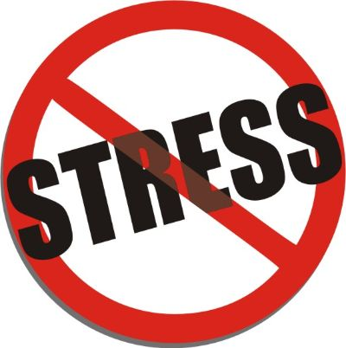
Managing stress in daily life
Stress is not an illness, but it can cause illness if it isn’t addressed.
Recognising the signs and symptoms of stress.
Identifying stressors/triggers and address the cause.
Establish coping strategies.
Exercise
=
Notes:
Spotting the early signs of stress will help prevent it getting worse and potentially causing complications such as high blood pressure.
There is little you can do to prevent stress, note there are many things you can do to manage stress more effectively such as learning how to relax, take regular exercise and adopting good time management techniques
Recognising stress triggers will be helpful in managing the stress going forward. If you're not sure what's causing your stress, keep a diary and make a note of stressful episodes for two-to-four weeks. Then review it to spot the triggers.
If the stress is related to a work issue then raise this with the line manager or HR department they will have processes in place to offer support and guidance.

Slide 7
Where to get help and support
Employer/HR department
Team Leader
Trade Union Representative
Occupational Health
GP for advice and assessment
Stress management courses
Counselling/CAB
Self help books/DVD’s/WWW
Confidential Help Line
HSE Website http://www.hse.gov.uk/stress/

